Slide 1
Object Oriented Programming
Iván Guerrero Román

Slide 2
Session $5
OO design
Grammatical method and CRC cards (class-responsibility-collaboration).
Inheritance relationship (is-a)
Composition relationship (has-a)
Modeling classes with the grammatical method

Slide 3
Multiplicity of the relations
Syntax | Meaning
0..1 | Zero or one element
1 | Exactly 1
0..* | Zero or many elements
1..* | One or many elements
n | N number of elements (n>1)
0..n | From zero to n elements
1..n | From 1 to n elements

Slide 4
Implementing Relationships in a Class Diagram
Composition
Container
public class Container {
private Component myComponent;
public Container() {
myComponent = new Component();
}
}
- Component myComponent
1
Component
public class Component{
…
}

Slide 5
Implementing Relationships in a Class Diagram
Composition
Container
public class Container {
private Component myComponent;
public Container() {
myComponent = new Component();
}
}
Important
Members of a container are not shared by other containers
Destroying the container destroys the elements
Removing the container prevents the component from working
- Component myComponent
1
Component
public class Component{
…
}

Slide 6
Implementing Relationships in a Class Diagram
Aggregation
Container
public class Container {
private Component myComponent;
public void setComponent(Component c) {
myComponent = c;
}
}
- Component myComponent
Important
Members of a container can be shared by other containers
Destroying the container does not destroy the component
Removing the container does not prevent the component from working
+ void setComponent (Component)
1
Component
public class Component {
…
}

Slide 7
Implementing Relationships in a Class Diagram
Association
MainClass
public class MainClass {
public void useTool(Tool t) {
…
t.doSomething();
}
public void method() {
Tool t = new Tool();
t.doSomething();
}
}
Important
It is a relation between the objects of the classes
An object of the main class effects an action (uses, for example) with an object of the class tool
+ void useTool(Tool)
+ void method()
<<use>>
Tool
public class Tool {
public void doSomething() {
…
}
}
+ void doSomething()

Slide 8
Implementing Relationships in a Class Diagram
Inheritance
ParentClass
public class ParentClass {
…
}
Important
If X is a subclass of Y, then the objects of X can be stored as objects of Y
The tasks performed by the objects of Y can be performed by the objects of X
ChildClass
public class ChildClass extends ParentClass {
…
}

Slide 9
Aggregation
A factory builds vehicles for the Tesla brand. To produce a unit, it requires knowing the model, color, if it requires autopilot, tire size and motor torque. Once the vehicle is finished, a review of the following aspects is carried out:
Time to reach 60 mph
Proper operation of the autopilot
Maximum speed
This report is attached to each vehicle.

Slide 10
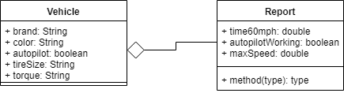
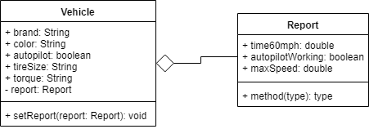

Slide 11
Exercise
A school wants to keep students records. The information collected is their name, surnames, date of birth, date of registration, career and home address. The address consists of street, exterior number, interior (optional), colony and zip code.

Slide 12
Session $5
OO design
Grammatical method and CRC cards (class-responsibility-collaboration).
Inheritance relationship (is-a)
Composition relationship (has-a)
Modeling classes with the grammatical method

